Slide 1



REINVIGORATING BLACKBERRY
Student Names:
Course Code:
Instructor’s Name:
Date:

Slide 2


COLORS, FONTS, AND BRAND GUIDELINES
Colors, Fonts, and Brand Guidelines
  Primary Colors:
    Black (#000000) – Represents security and legacy heritage
    Magenta (#E01A72) – BlackBerry official accent
    White (#FFFFFF) – Clean and modern background
  Fonts:
    Title & Headings: Montserrat
    Body Text: Open Sans
    Consistency: Use bold for emphasis, avoid decorative fonts
  Brand Guidelines:
    Minimal, balanced slides
    High-quality visuals
    Clear hierarchy of text

Slide 3


TABLE OF CONTENT
  Project Brief
  Project Objective
  Goal
  Chosen Company + Hypothesis
  Draft Approach
  References

Slide 4
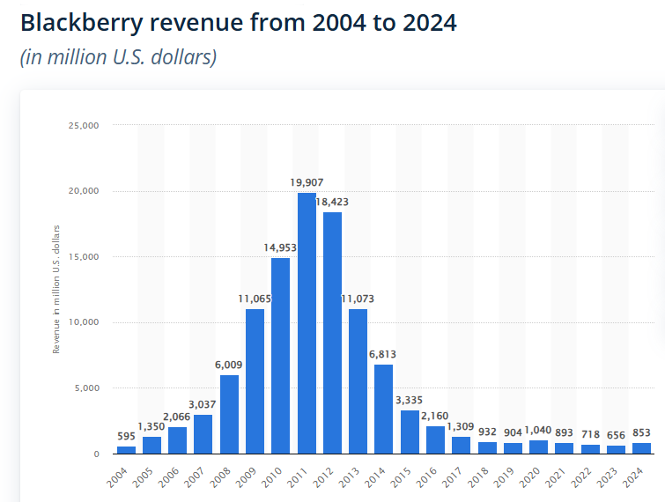
PROJECT BRIEF
BlackBerry used to be a leader in mobile communication technology, in which it controlled the smartphone market through secure messaging and physical keyboards. It had a massive market share around 2011, and it could not adjust to touchscreen innovation and evolving consumer requirements (Statista, 2026). This made the market value and relevance of BlackBerry crash drastically. It no longer manufactures phones and has moved on to cybersecurity and software services, but its financial performance is poor in comparison to the peers. To stay alive and prosper, BlackBerry should be able to reinvent its brand and resonate with the current generation (SunStar, 2024).

Slide 5

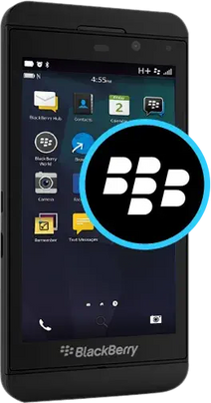
PROJECT OBJECTIVE
To analyse the downfall of BlackBerry and find a new opportunity avenue that would fit into its strength. Our objective is to establish a reinvention programme that makes BlackBerry a new brand worth believing in once more, a brand that can be used by digital users but whose security background will be used to its advantage.

Slide 6

GOAL
The goal is to rebrand BlackBerry within the circumstances of mobile lifestyle and concentrate on privacy, control, and digital wellbeing. Users who are tired of being bombarded by data tracking, numerous notifications, and addictive app ecosystems will use the brand.

Slide 7
CHOSEN COMPANY + HYPOTHESIS
Company: BlackBerry Limited
BlackBerry used to be a mobile phone empire but is currently specialized in enterprise and (connected device) software cybersecurity and software (Reuters, 2025). The recent revenue forecasts indicate its vulnerability and reduces demand in the traditional enterprise cybersecurity services (Statista, 2025).
Hypothesis:
If BlackBerry repositions itself as the flagship brand in the digital wellness and privacy-conscious devices, it will be able to appeal to a new generation of users who feel disillusioned by the existing smartphone ecosystems and capitalise on its track record of safety and trust (Youssef Haj Youssef, 2013).

Slide 8
The Modern Digital Stress Ecosystem
Notification Systems → constant alerts → attention fragmentation
Social Media Platforms → endless feeds → addictive usage
Digital stress is not caused by one factor, but by an interconnected system of platforms, notifications, and data-driven technologies (Grieva et al., 2025).
This environment creates an opportunity for a technology brand positioned around privacy, focus, and controlled communication.
Data Tracking & Algorithms → behavior monitoring → privacy anxiety
Modern Smartphone User
App Ecosystems → multitasking → cognitive overload
Work & Academic Expectations → always reachable → pressure

Slide 9
Daily Digital Interaction Journey
Phase | User Activity | Cognitive State | System Influence | Opportunity Insight
Morning | Checks phone immediately | Alert but distracted | Notifications & feeds | Need for controlled notification intake
Midday | Work/study communication | Fragmented focus (Reuters, 2025) | App multitasking | Opportunity for focus-oriented interface
Afternoon | Passive scrolling | Reduced productivity | Algorithmic loops | Need for intentional-use design
Evening | Messaging & streaming | Mental fatigue | Continuous connectivity | Need for digital boundary features
Night | Late scrolling | Overstimulated, guilty | Infinite feeds | Need for distraction-free modes
Cognitive overload accumulates through the day due to engagement-driven system design.

Slide 10
USER PAIN AND NEEDS ANALYSIS
Functional Needs
Fewer distractions
Simpler device interaction
Transparent privacy controls
Privacy Needs
Limited data tracking
Secure communication
Clear permission management
Emotional Needs
Reduced anxiety
Feeling in control
Mental calm (Reuters, 2025)
User needs are shifting from feature abundance to intentional, controlled technology use (Sexton et al., 2022).

Slide 11
Gap Between Current Smartphone Systems and User Expectations
Current Smartphone Design | Emerging User Expectation
Engagement-driven (Reuters, 2025) | Focus-driven
Data monetization | Privacy-first
Infinite scrolling | Intentional usage
Constant alerts | Controlled attention
App overload | Simplified ecosystem
There is a structural gap between dominant smartphone logic and growing demand for digital wellbeing (Shin, 2025).
BlackBerry’s legacy in secure, purposeful communication aligns with this unmet need.

Slide 12
ALIGNMENT OF BLACKBERRY STRENGTHS WITH EMERGING NEEDS
BlackBerry Capability | Related User Demand
Security expertise | Privacy protection
Trusted brand heritage | Confidence in device integrity
Experience in communication tools | Purposeful connectivity
Enterprise software background | Controlled system architecture
Insight: BlackBerry’s historical strengths directly match the identified opportunity space (Massenon et al., 2024).

Slide 13
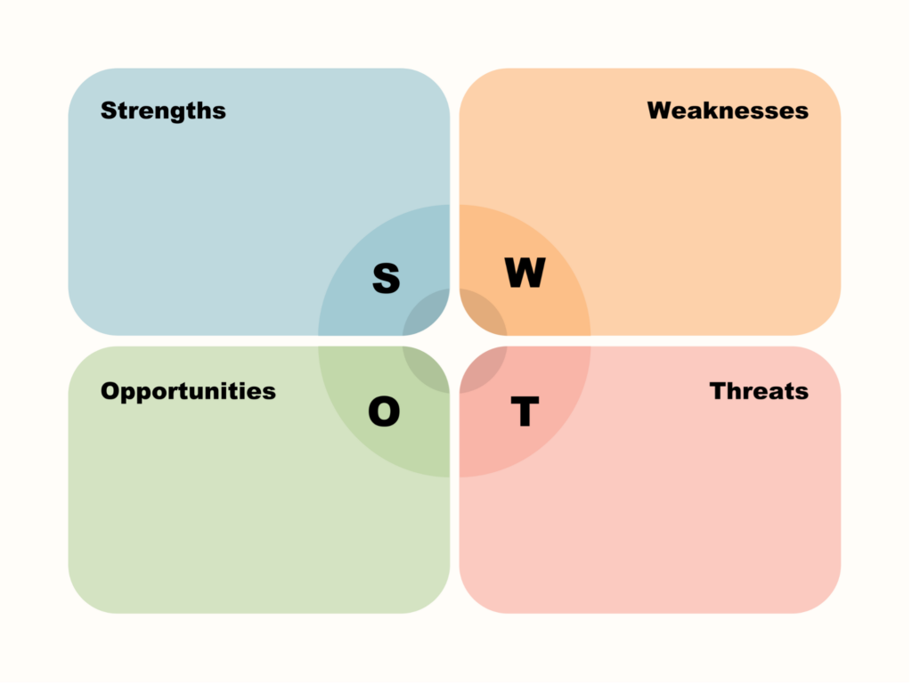
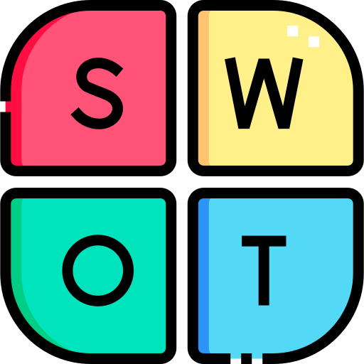
STRATEGIC POSITION OF BLACKBERRY
Security reputation
Brand trust
Software expertise
Reduced consumer presence
Outdated brand perception
Limited hardware ecosystem
Dominance of Apple & Google
Rapid innovation cycles
Competitive ecosystems
(statista, 2025)
Privacy concerns rising
Digital wellbeing trend
Desire for minimal tech

Slide 14

CORE VALUE PROPOSITION
Privacy dashboard
Optional physical keyboard
Distraction-free modes
Security Meets Simplicity
User Outcome:
Focus • Control • Trust • Mental Calm
Secure operating system
Minimalist interface

Slide 15
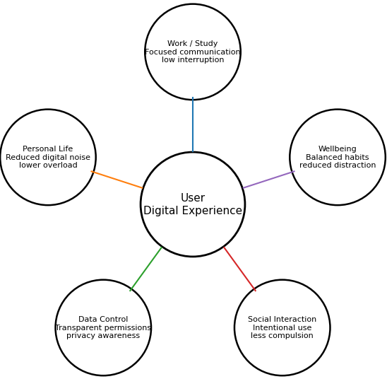

User-Centered Experience Ecosystem
This ecosystem model will be used to show how the redesign BlackBerry experience can run in the key life situations. Rather than forcing attention, the system helps in focused work and controlled data use, deliberate social interaction, and enhancement of digital wellbeing.

Slide 16

ENVISIONED FUTURE STATE BY BlackBerry
Technology supports focus rather than interrupts it (George et al., 2023)
Privacy is integrated, not optional
Devices encourage intentional use
Users experience reduced digital stress (Godliauskas, & Šmite, 2025)

Slide 17

Reinvention Direction for BlackBerry
  The analysis shows that BlackBerry has a chance of repositioning as a privacy and digital wellbeing brand. As part of its security legacy and concentrated on simplified and controlled experience with technology, BlackBerry can respond to unmet user demands within the existing smartphone ecosystem.

Slide 18


DRAFT APPROACH
  Develop a privacy-focused lifestyle device
  Emphasize security, focus, and minimalism
  Conduct user research on digital fatigue (Reuters, 2025)
  Prototype features: physical keyboard option, privacy dashboard, distraction-free modes (SunStar, 2024)
  Positioning theme: Security Meets Simplicity

Slide 19
REFERENCES
  Statista. (2026). BlackBerry – statistics & facts. Statista. https://www.statista.com/topics/5316
  SunStar. (2024). Dissecting the rise, fall of BlackBerry. https://www.sunstar.com.ph/cebu/lifestyle/dissecting-the-rise-fall-of-blackberry
  George, A. S., George, A. H., & Baskar, T. (2023). The death of analog: Assessing the Impacts of ubiquitous mobile technology. Partners Universal Innovative Research Publication, 1(2), 15-33. http://www.puirp.com/index.php/research/article/view/17
  Reuters. (2025, April 2). BlackBerry forecasts lower annual revenue due to weak demand for cybersecurity services. https://www.reuters.com/technology/blackberry-forecasts-lower-annual-revenue-due-weak-demand-cybersecurity-services-2025-04-02/
  Youssef, M. H., & Haj Youssef, M. (2013). Strategic tensions within the smartphones industry: the case of BlackBerry. VISTAS: Education, Economy and Community, 3, 125-141. https://westminsterresearch.westminster.ac.uk/item/967yy/strategic-tensions-within-the-smartphones-industry-the-case-of-blackberry
  Sexton, V., Dale, J., Bryce, C., Barry, J., Sellers, E., & Atherton, H. (2022). Service use, clinical outcomes and user experience associated with urgent care services that use telephone-based digital triage: a systematic review. BMJ open, 12(1), e051569. https://bmjopen.bmj.com/content/12/1/e051569.abstract
  Grieva, O., Guadamillas, F., Donate, M. J., & Appio, F. P. (2025). The digital, knowledge and innovation nexus: mapping synergies and charting a research agenda. Journal of Knowledge Management, 1-42. https://www.emerald.com/jkm/article/doi/10.1108/JKM-03-2025-0425/1308888
  Statista. (2025). BlackBerry revenue worldwide from 2004 to 2024 (in million U.S. dollars). Statista. https://www.statista.com/statistics/266240/blackberry-revenue/
  Massenon, R., Gambo, I., Ogundokun, R. O., Ogundepo, E. A., Srivastava, S., Agarwal, S., & Pak, W. (2024). Mobile app review analysis for crowdsourcing of software requirements: a mapping study of automated and semi-automated tools. PeerJ Computer Science, 10, e2401. https://peerj.com/articles/cs-2401/
  Shin, Y. (2025). Toward human-centered artificial intelligence for users’ digital well-being: Systematic review, synthesis, and future directions. JMIR Human Factors, 12(1), e69533. https://humanfactors.jmir.org/2025/1/e69533/
  Godliauskas, P., & Šmite, D. (2025). The well-being of software engineers: a systematic literature review and a theory. Empirical Software Engineering, 30(1), 35. https://link.springer.com/article/10.1007/s10664-024-10543-8

Slide 20
THANK YOU

